Slide 1







SPACEX Launches
Sidra
4 August 2023

Slide 2



OUTLINE
Executive Summary
Introduction
Methodology
Results
Visualization – Charts
Dashboard
Discussion
Findings & Implications
Conclusion
Appendix

Slide 3

EXECUTIVE SUMMARY
This data science project aims to leverage historical launch data and machine learning techniques to predict the likelihood of SpaceX reusing the first stage of their rockets. The insights gained from the analysis could have far-reaching implications for SpaceX's operational strategies and the broader aerospace sector's approach to reusability.
The aim of this data exploratory project is to develop a machine learning model using publicly available data to predict the likelihood of SpaceX reusing the first stage of their rockets after a launch. By analyzing historical launch data and mission-specific factors, the project seeks to provide insights into the reusability strategy of SpaceX.
The project will gather a dataset of SpaceX launch information, encompassing details about launch dates, launch sites, payload mass, and outcomes (successful reuse or not). Publicly accessible sources, such as SpaceX's official records and launch databases, will serve as the primary data sources. The collected data will undergo thorough preprocessing to handle missing values.
After preprocessing, relevant features will be selected to train a machine learning model. Various machine learning algorithms will be evaluated, such as logistic regression, and decision trees to determine the most effective predictive model.
The dataset will be divided into training and testing sets to simulate real-world performance. Metrics such as accuracy score and confusion matrix will be employed to quantify the model's predictive capability.

Slide 4

INTRODUCTION
In the rapidly evolving landscape of space exploration, SpaceX has emerged as a pioneering force, revolutionizing the way we access and utilize space. One of the company's groundbreaking innovations has been the concept of reusing rocket components, specifically the first stage of their Falcon 9 rockets.
This data exploratory project uses data science to uncover the factors that influence SpaceX's first stage reusability. By using machine learning and analyzing publicly available data, this project seeks to predict the likelihood of SpaceX reusing the first stage after each launch. The insights garnered from this predictive model could provide a deeper understanding of SpaceX's operational decisions and reveal patterns that contribute to successful reusability.
The project revolves around the idea that historical launch data, when combined with payload specifications, and mission-specific outcomes, can offer valuable insights into SpaceX's reusability strategy. The analysis and predictions derived from this model could potentially guide decisions, streamline operational processes, while maintaining efficiency for the new SpaceY's space missions.

Slide 5

METHODOLOGY
The primary source of data for this analysis will be SpaceX's official records, including launch dates, mission outcomes, and details about the first stage reusability status. These records will serve as the foundation for building the predictive model.
The project will begin by systematically collecting data from SpaceX's official records and launch databases. Information regarding launch dates, mission objectives, payload types, and reusability outcomes will be compiled.
Exploratory Data Analysis (EDA) will involve visualizing and summarizing the data to gain initial insights into potential correlations between variables and reusability outcomes. This step will guide feature selection and model development.
Following the EDA a model will be developed based on selected features such as launch data, payload mass and outcomes. Based on these features an appropriate model will be tested and trained, before the model's hyperparameters can be fine-tuned and the model can be evaluated.

Slide 6
RESULTS
SpaceX's official records, launch databases, and mission reports, were systematically collected to create a comprehensive dataset.
Information encompassing launch details, payload specifications, orbit, booster version and mission outcomes was organized into an appropriate dataframe.
Exploratory Data Analysis (EDA) was employed to visualize and uncover patterns between variables and reusability outcomes.
Key features influencing reusability were selected based on EDA insights, and machine learning models (e.g., logistic regression, decision trees) were developed using these features.
Models were evaluated using metrics like accuracy score, and confusion matrix to gauge predictive performance.

Slide 7
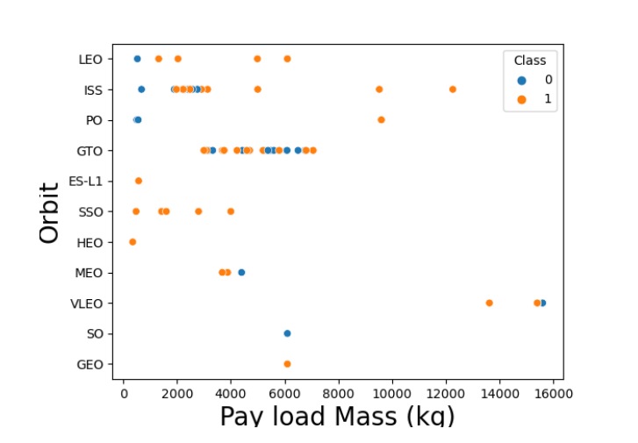
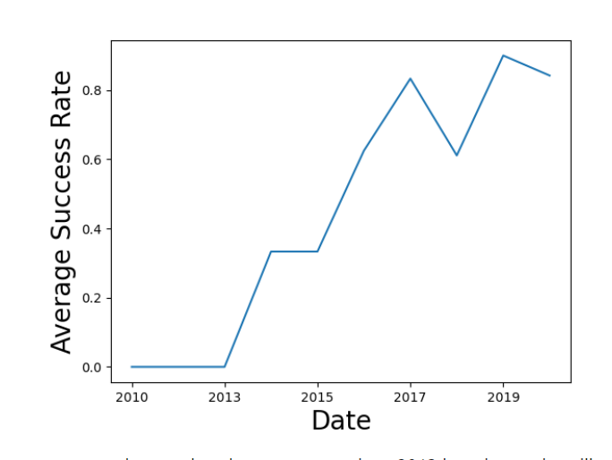
EDA with visualization result
Relationship between Payload and Orbit type
Average success rate over the years

Slide 8
EDA with visualization result
FINDINGS & IMPLICATIONS
Findings
It can be observed that the success rate since 2013 kept increasing till 2020
With heavy payloads the successful landing or positive landing rate are more for Polar,LEO and ISS.
However for GTO we cannot distinguish this well as both positive landing rate and negative landing(unsuccessful mission) are both there here.
Implications
The increasing success rate of first stage reusability, could simply mean that SpaceX has been refining their launch processes, and that continuous efforts have led to enhanced reusability success, contributing to cost savings.
The varying success rates based on payload type and orbits (Polar, LEO, ISS) suggest that SpaceX might be tailoring their reusability strategies to different mission profiles. This may mean that payload mass and mission profiles play a crucial role in determining the reusability success.
The inability to clearly distinguish positive landing rates from negative landing rates for missions to Geostationary Transfer Orbit (GTO) raises questions about the unique challenges associated with these types of missions, and may require further investigation.

Slide 9
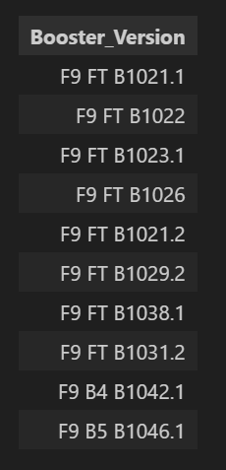
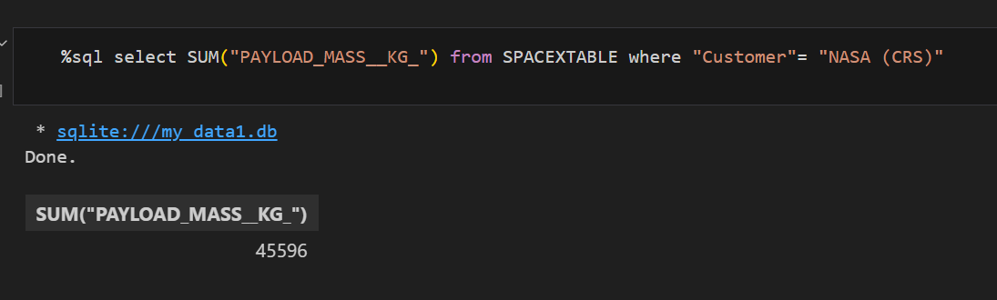
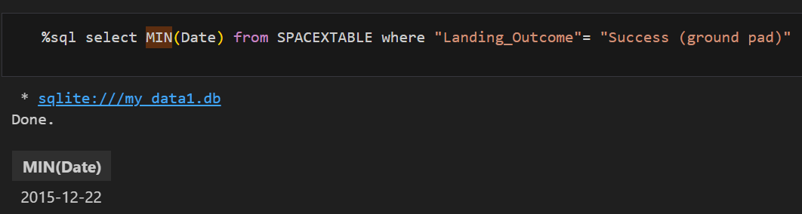
EDA with SQL results
Boosters with success in drone ship and a payload mass > 4000 but < 6000
Total payload mass carried by boosters launched by NASA (CRS)
First successful landing outcome in ground pad was achieved

Slide 10
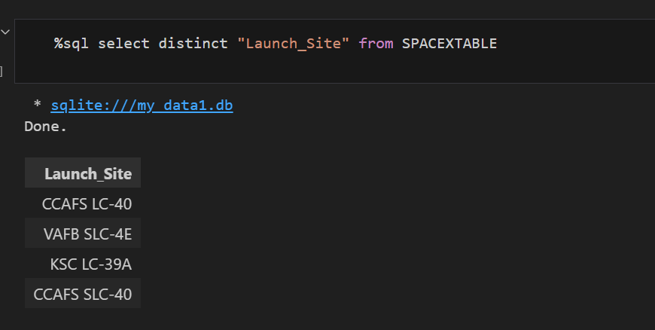
EDA with SQL results
Launch sites in the space mission
Booster versions which have carried the maximum payload mass
Booster_VersionF9 B5 B1048.4F9 B5 B1049.4F9 B5 B1051.3F9 B5 B1056.4F9 B5 B1048.5F9 B5 B1051.4F9 B5 B1049.5F9 B5 B1060.2F9 B5 B1058.3F9 B5 B1051.6F9 B5 B1060.3F9 B5 B1049.7

Slide 11
EDA with SQL - FINDINGS & IMPLICATIONS
Findings
The 4 launch sites for these missions include CCAFS LC-40, VAFB SLC-4E, KSC LC-39A and CCAFS SLC-40.
Most 'F9 FT' booster versions had a success in drone ship and a payload mass > 4000 but < 6000
Total payload mass carried by boosters launched by NASA (CRS) was 45596 kg
First successful landing outcome in ground pad was achieved on 22nd of December in 2015.
Implications
The presence of four distinct launch sites indicates that SpaceX might be strategically selecting launch sites based on mission requirements which could be driven by considerations such as proximity to desired orbits, allowing SpaceX to maximize mission success and reusability outcomes.
The correlation between 'F9 FT' booster versions, success in drone ship landings, and a specific payload mass range (4000-6000 kg) suggests that SpaceX may have designed these booster versions to excel in particular scenarios.
The observation of payload mass carried by boosters launched by NASA (CRS) may imply that NASA's collaboration with SpaceX is significant in terms of payload utilization and that the partnership between them is fostering technological advancements and contributing by efficiently delivering substantial payload masses to space.

Slide 12
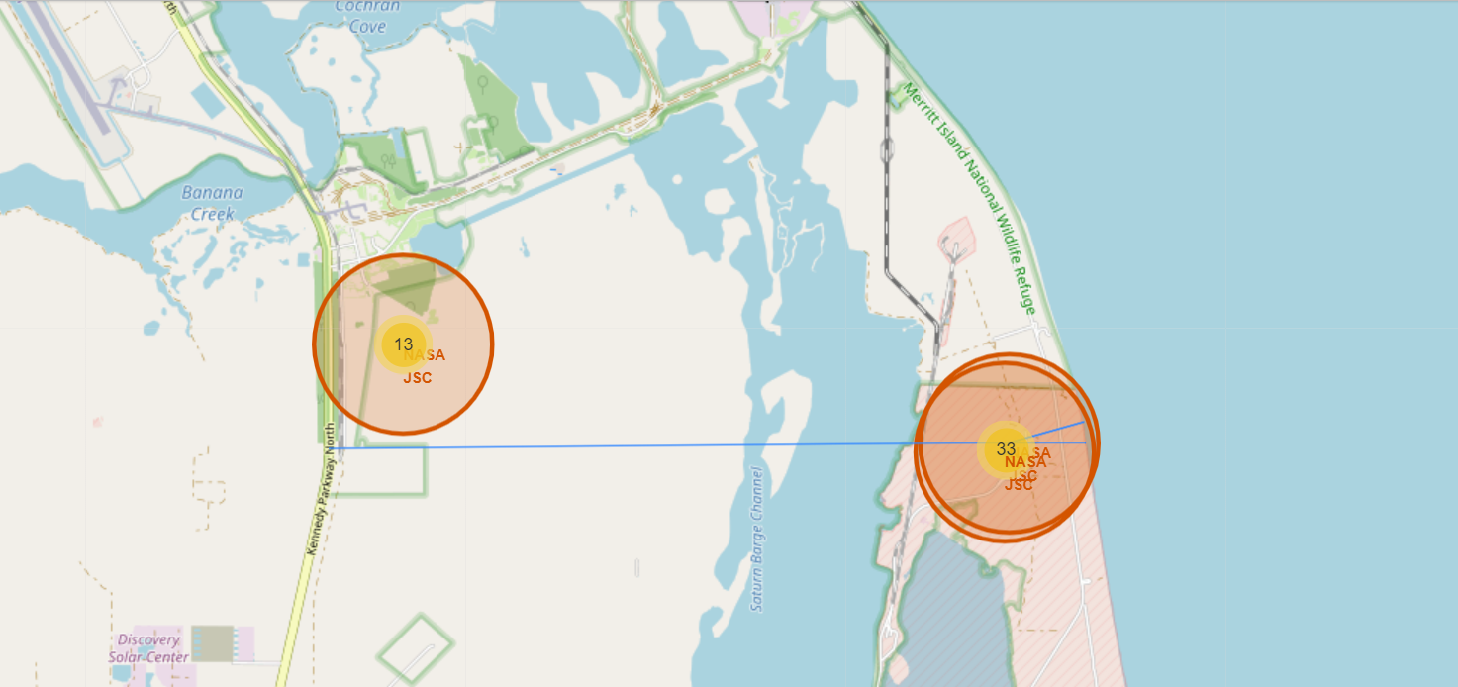
Interactive map with Folium results slides

Slide 13
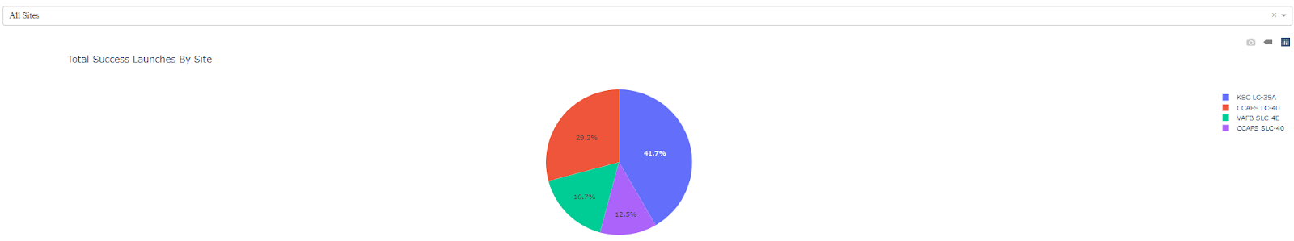
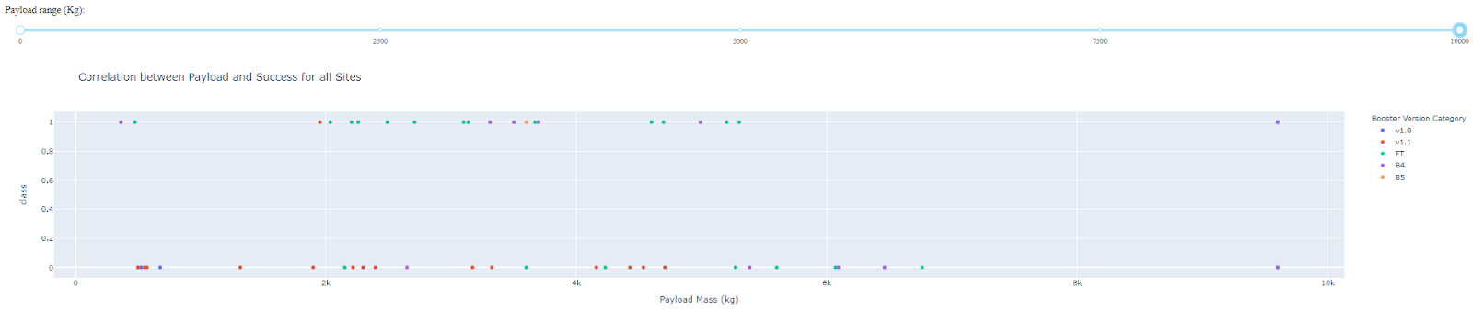
Plotly Dash dashboard results

Slide 14
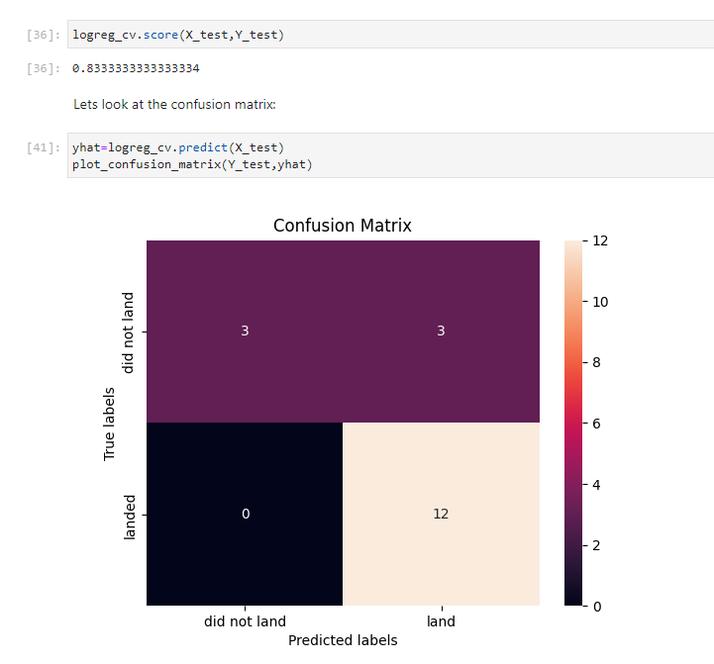
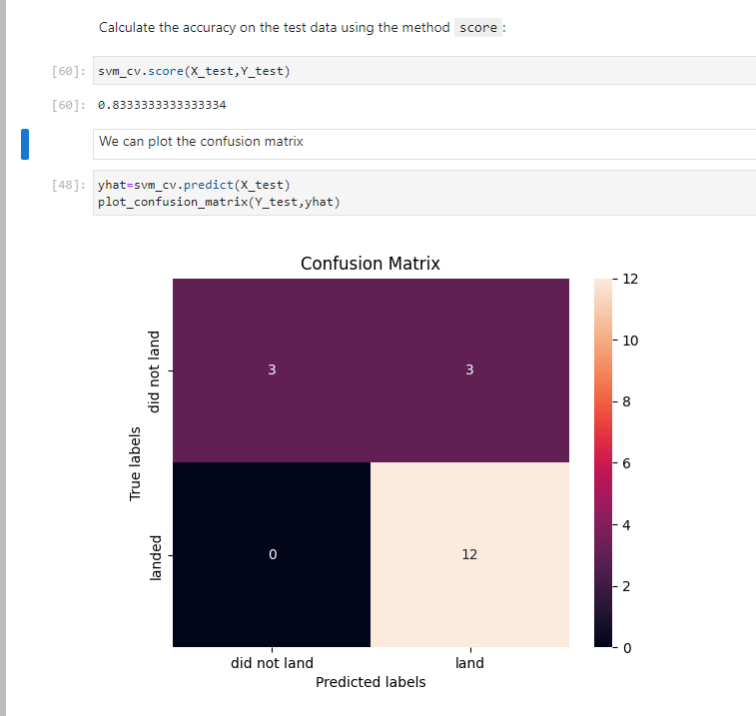
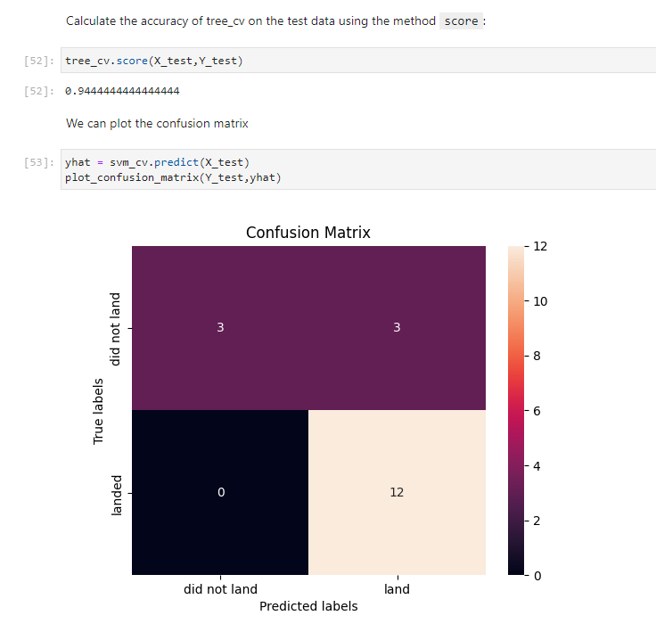
Predictive analysis (classification) results
Logistic Regression SVM Decision Trees

Slide 15

CONCLUSION
The observed upward trend in first stage reusability success rates from 2013 to 2020 shows SpaceX's continuous commitment. This evolution signifies the ability to learn from each launch, refine processes, and apply lessons to subsequent missions, resulting in improved reusability outcomes
The varying success rates across different payload types and mission destinations indicate a strategic approach to reusability based on specific mission requirements. The higher success rates for heavy payloads to Polar, LEO, and ISS orbits suggest tailored strategies for these missions.
The challenges associated with Geostationary Transfer Orbit (GTO) missions, where distinguishing between successful and unsuccessful outcomes is less clear, highlight the intricacies of achieving reusability under specific conditions.
Incorporating these insights into its business strategy and operations can empower the new company SPACEY to navigate challenges, optimize reusability, and establish itself as a competitive player in the industry. By learning from SpaceX's experiences, the new company can accelerate its growth and contribute to the space exploration.

Slide 16
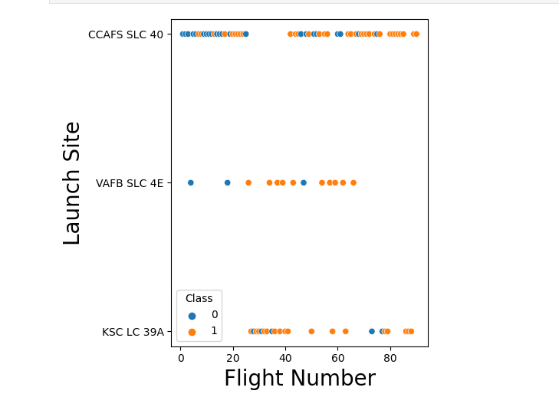
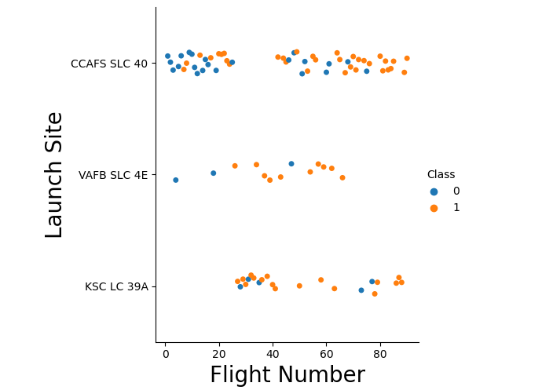
APPENDIX

Slide 17
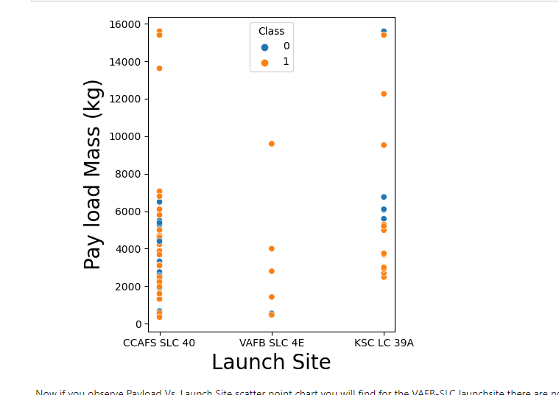
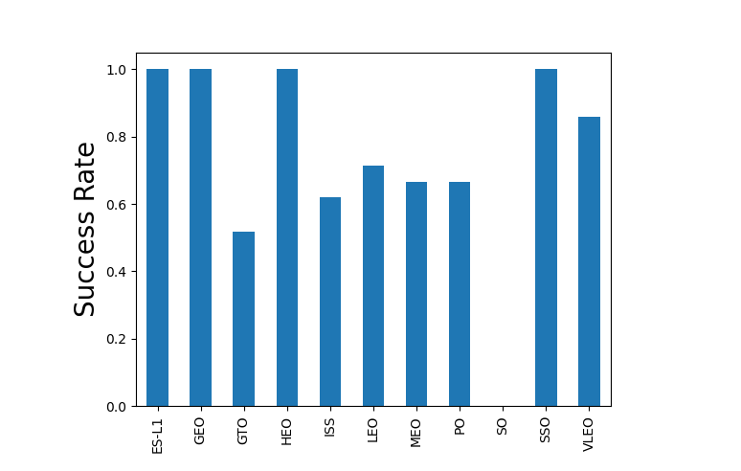
APPENDIX

